Slide 1
Exp 9
Identity Access Management
By
Elvis D'souza (8333),
Sherwyn D'souza (8334)

Slide 2
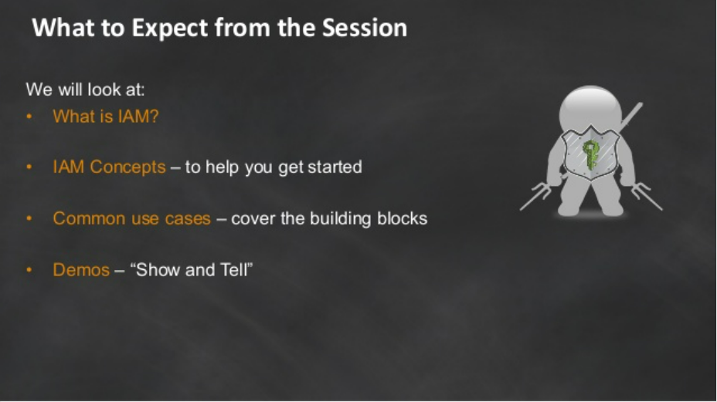

Slide 3
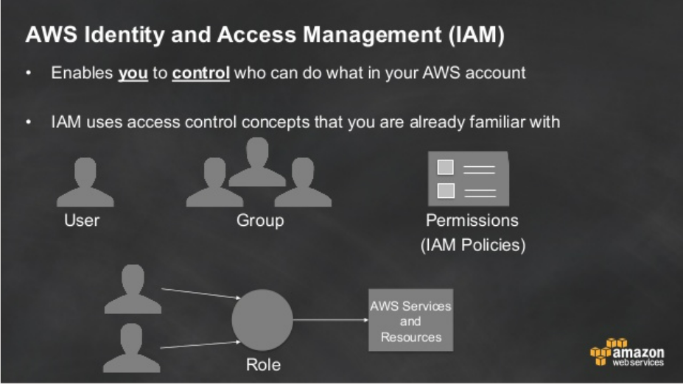

Slide 4
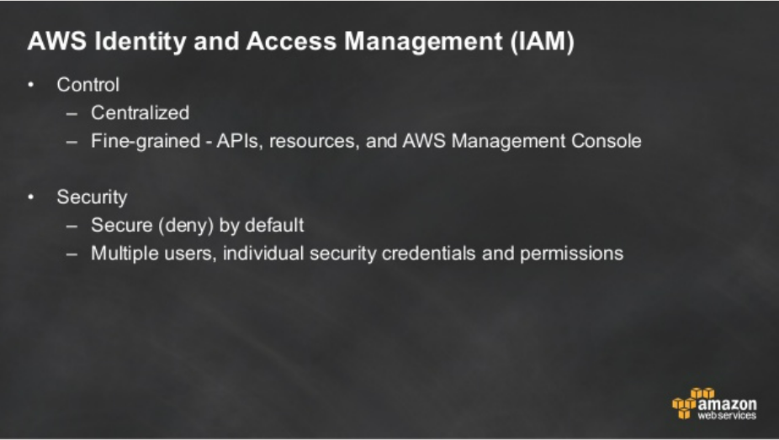

Slide 5
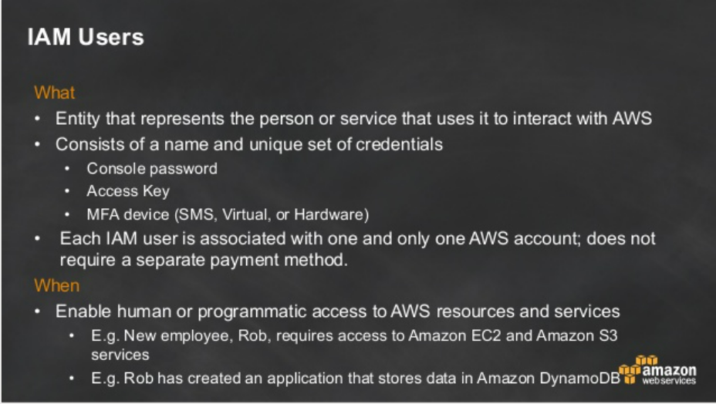

Slide 6
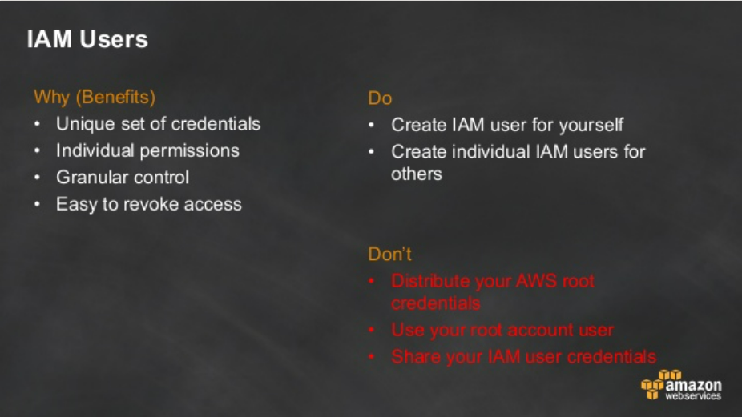

Slide 7
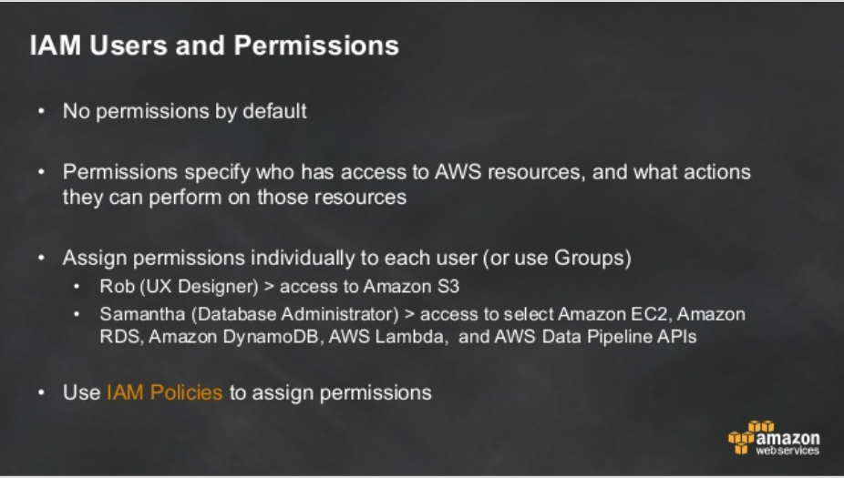

Slide 8
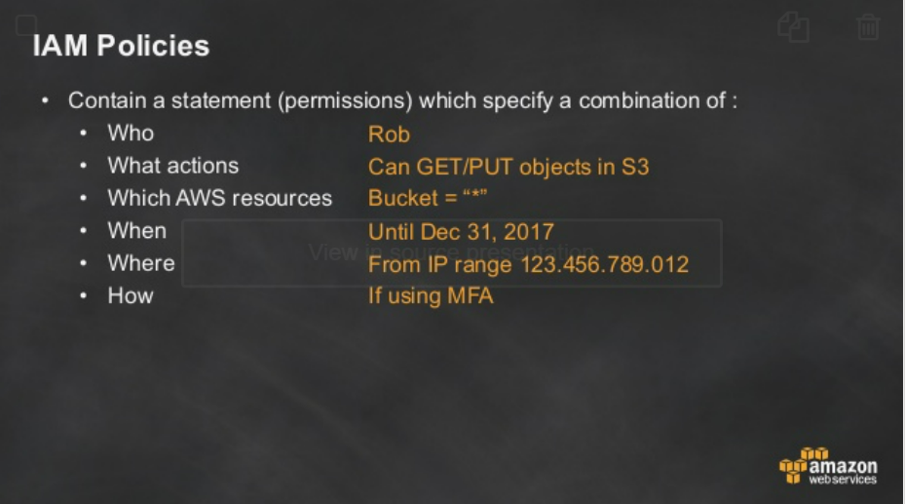

Slide 9
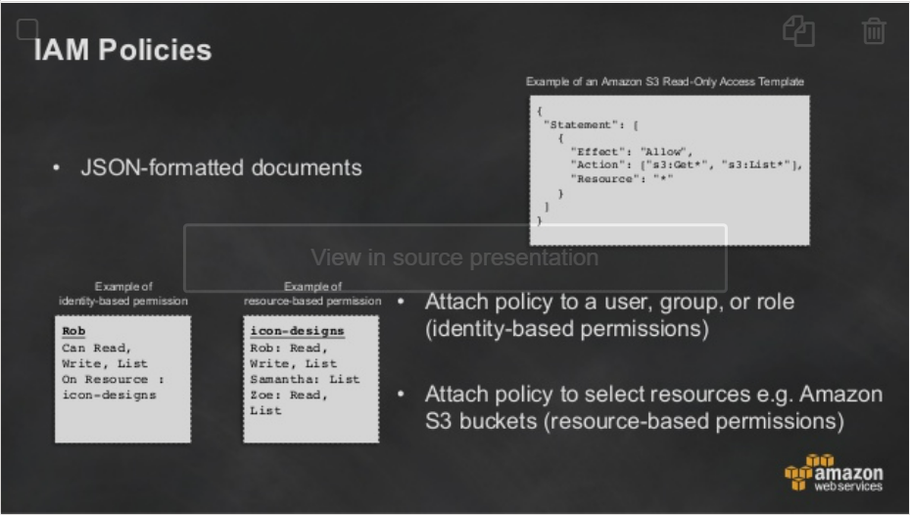

Slide 10
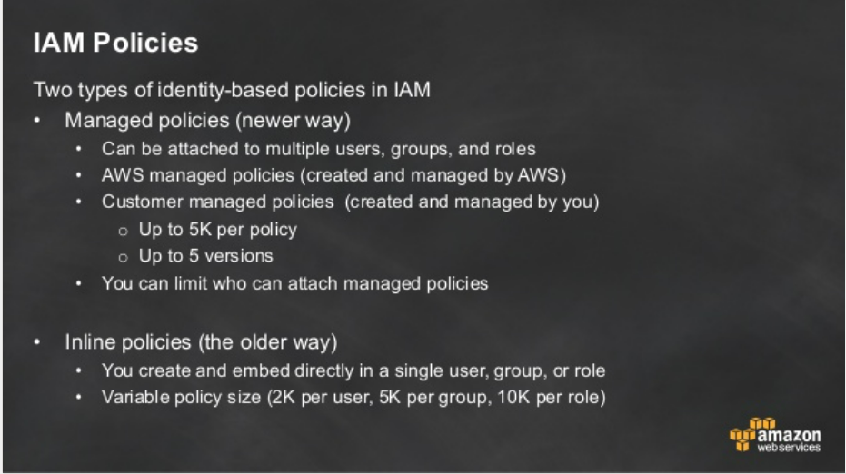

Slide 11
IAM POLICIES
Resource-based policies control what actions a specified principal can perform on that resource and under what conditions. Resource-based policies are inline policies, and there are no managed resource-based policies. To enable cross-account access, you can specify an entire account or IAM entities in another account as the principal in a resource-based policy.

Slide 12
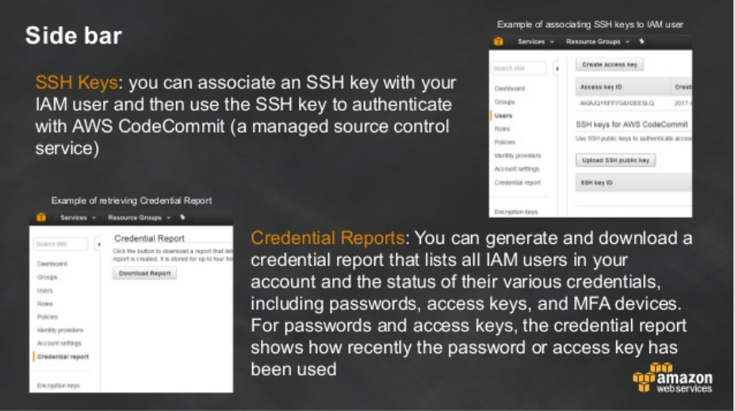

Slide 13
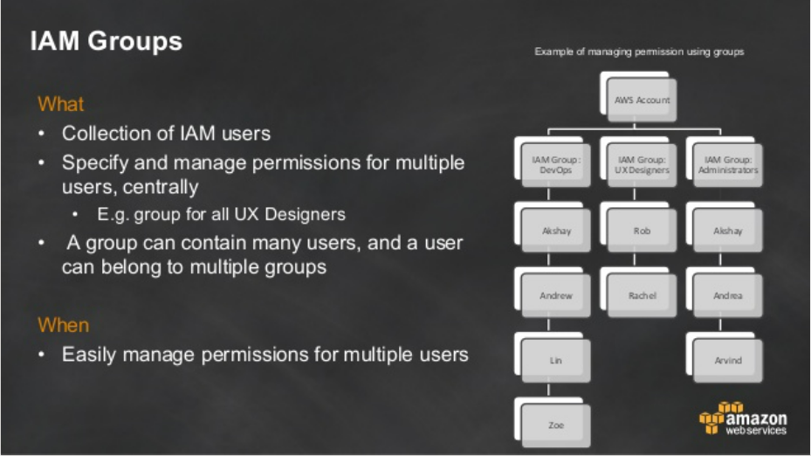

Slide 14
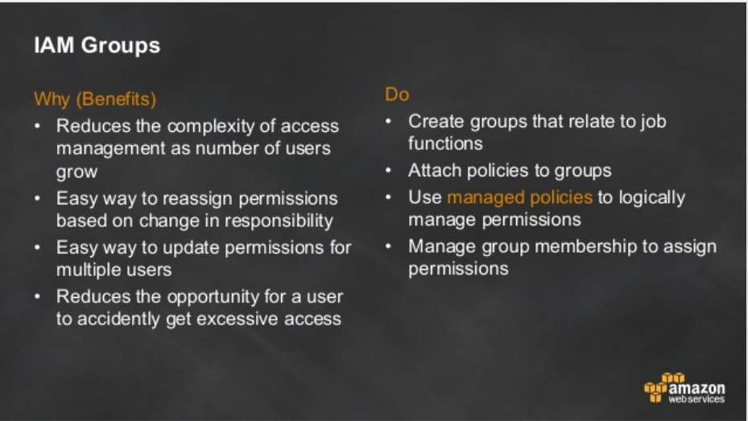

Slide 15
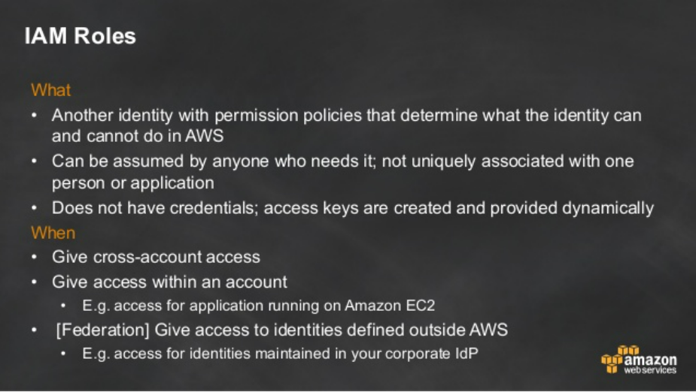

Slide 16
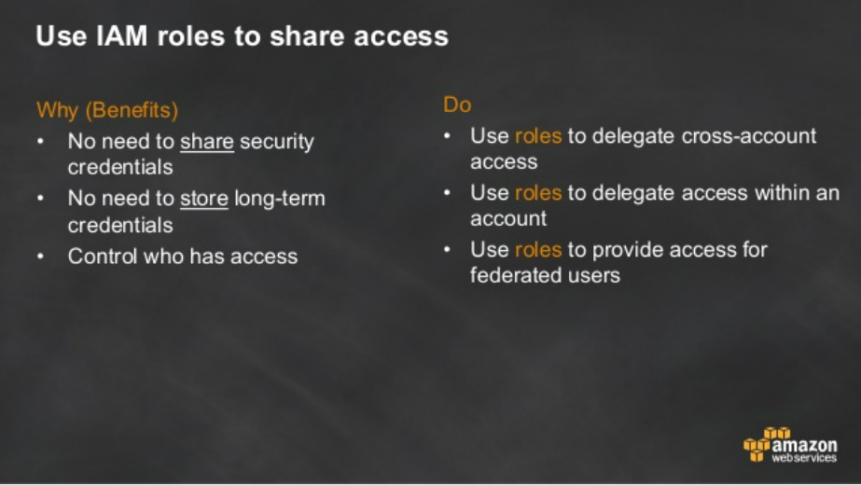

Slide 17
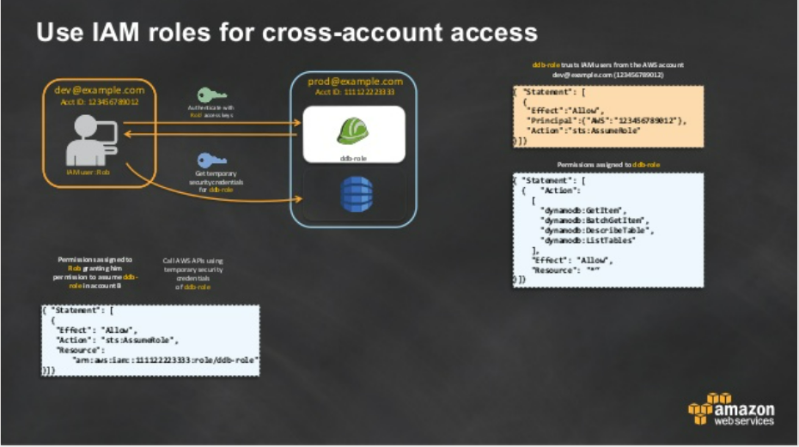

Slide 18
THANK YOU

